Slide 1






Optimizing job posts and recruiting communications at leading organizations
What we can expect if we buy Textio Recruiting

Slide 2
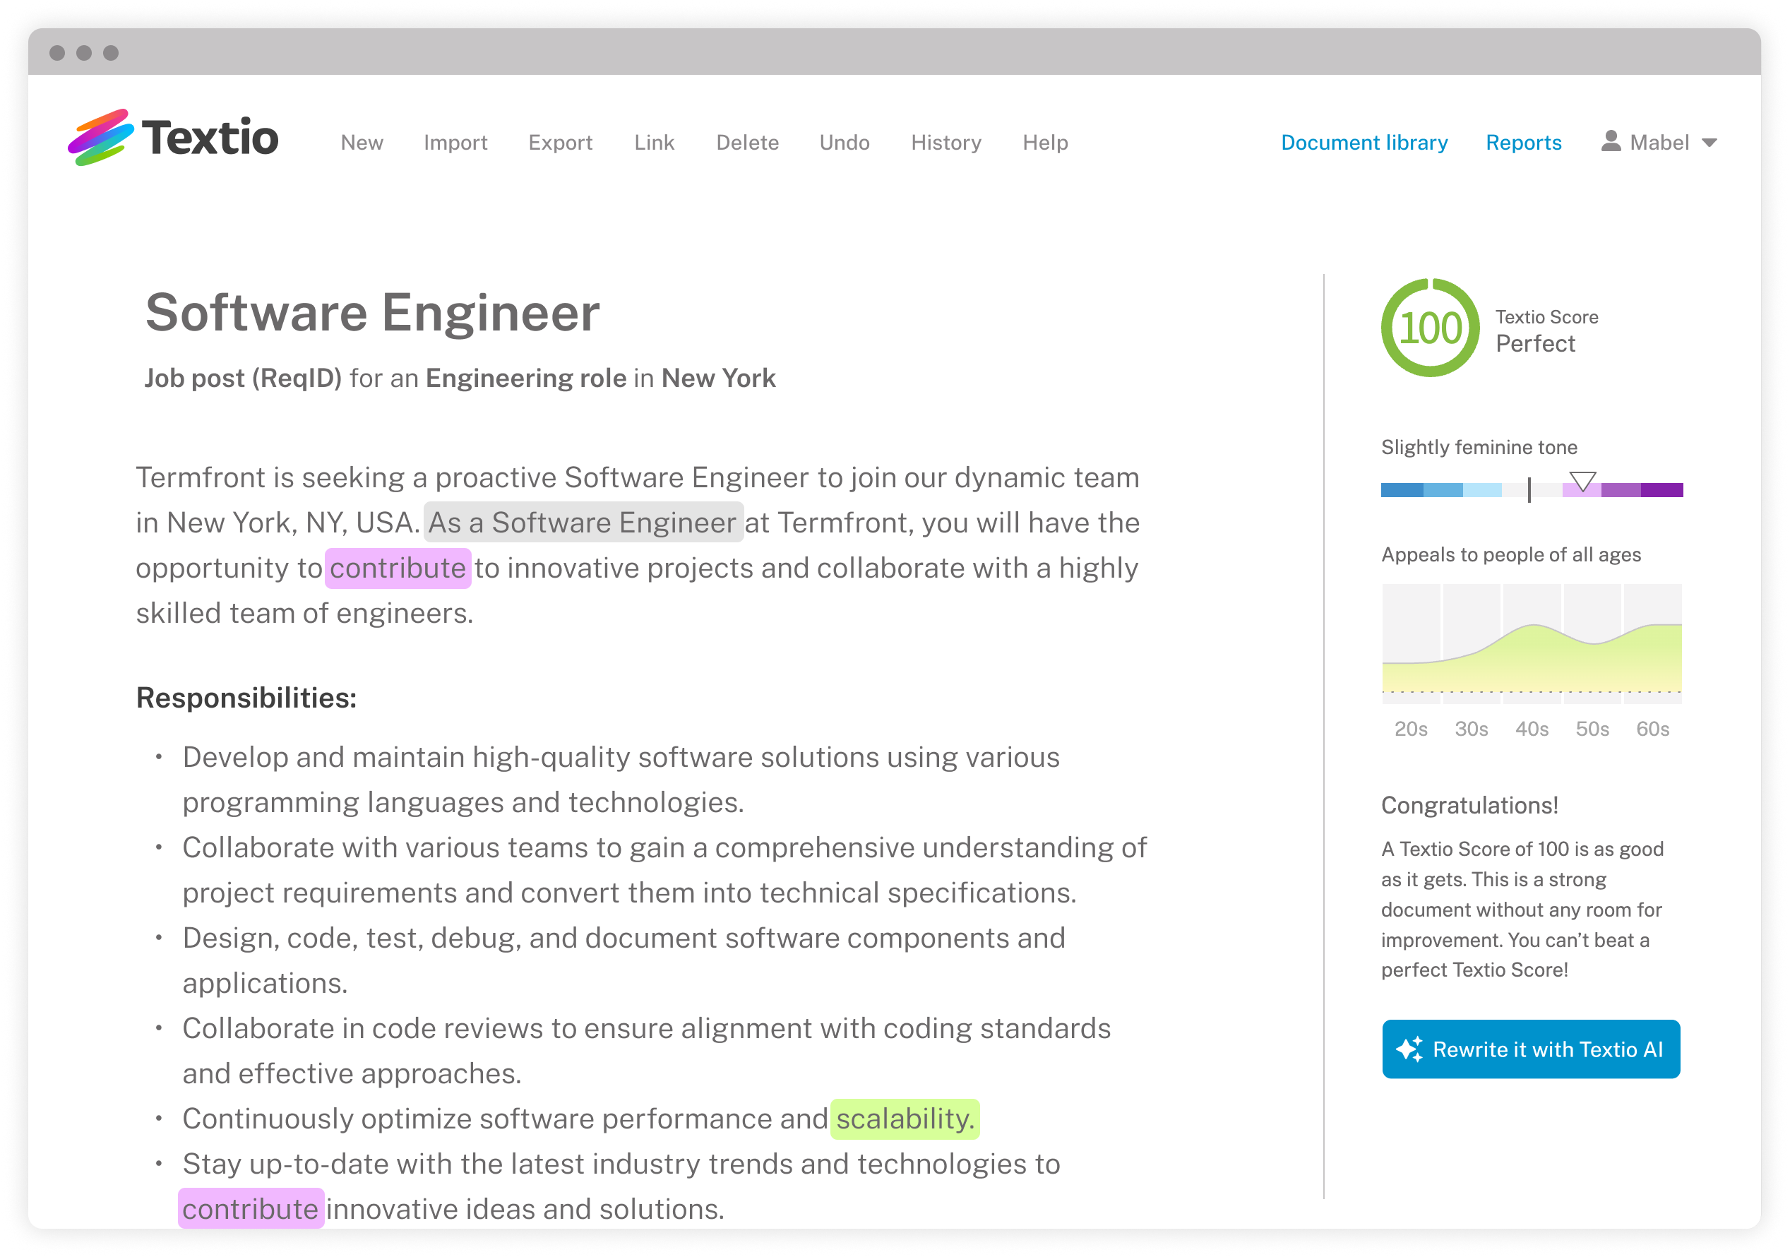

Textio would be a new way for us to attract top talent with better job descriptions
What we could do, but can’t today:
Compete for a wider pool of top talent
Recruit faster, and more efficiently
Create an exceptional candidate experience

Slide 3
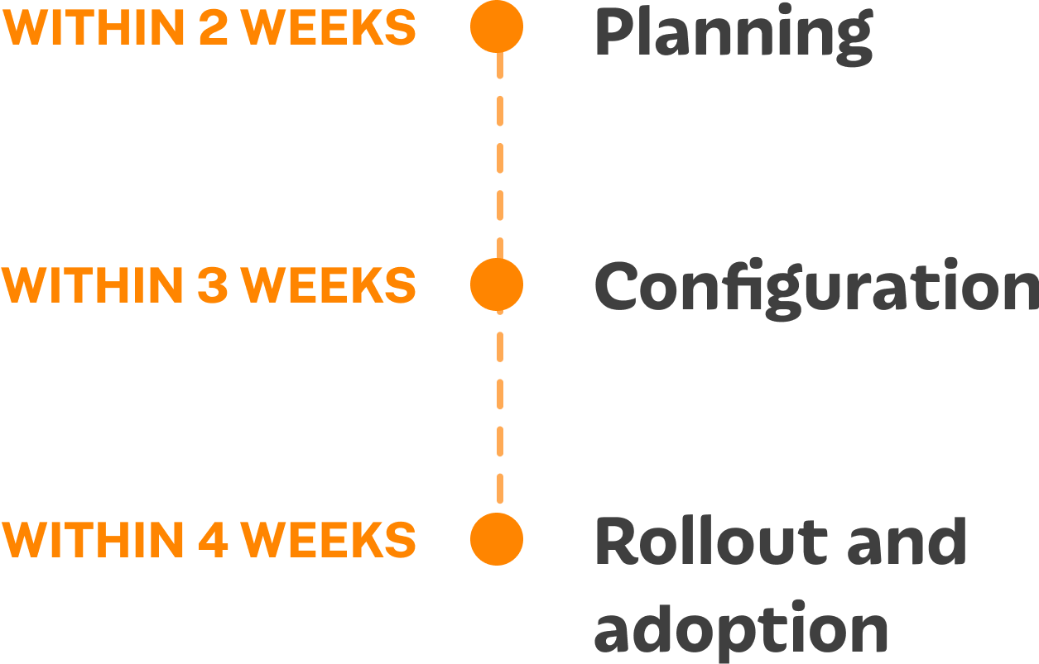
Anticipated timeline
What’s involved:
Textio customers are typically onboarded and recruiting top talent in 1 month.
Developing an implementation plan
Education and enablement for users
Setting up SSO and Textio browser extension (if applicable)
Rolling out Textio to everyone

Slide 4




The impact we could have
If we could optimize all our jobs posts and recruiting communications
We would transform how we compete for top talent
This means we’d recruit more efficiently and fill roles faster
While creating an exceptional candidate experience

Slide 5

Additional return on investment
Recruit top talent faster
T-Mobile reduced their time-to-fill by 5 days on average for roles with a Textio Score of 90 or higher
Build inclusive, diverse pipelines
Zendesk improved representation of underrepresented groups (URGs) by combining Textio's language guidance with targeted hiring and development efforts
Elevate our employer brand
Duolingo standardized their job post introductions and boilerplate language, aligning it with their brand values and reducing jargon, leading to better engagement from candidates
Learn more and read case studies

